Slide 1
Digital Image Processing
Progress Report
Team: 1 Speaker: 趙宇涵 許立暘 Date: 2022/6/9

Slide 2
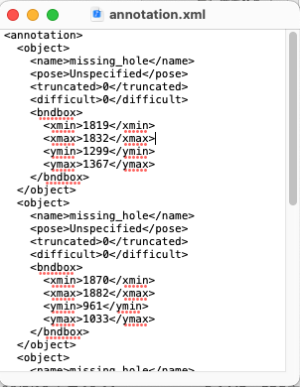
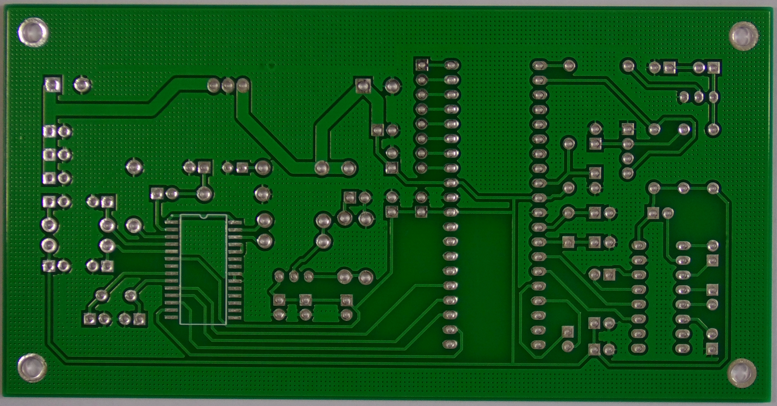

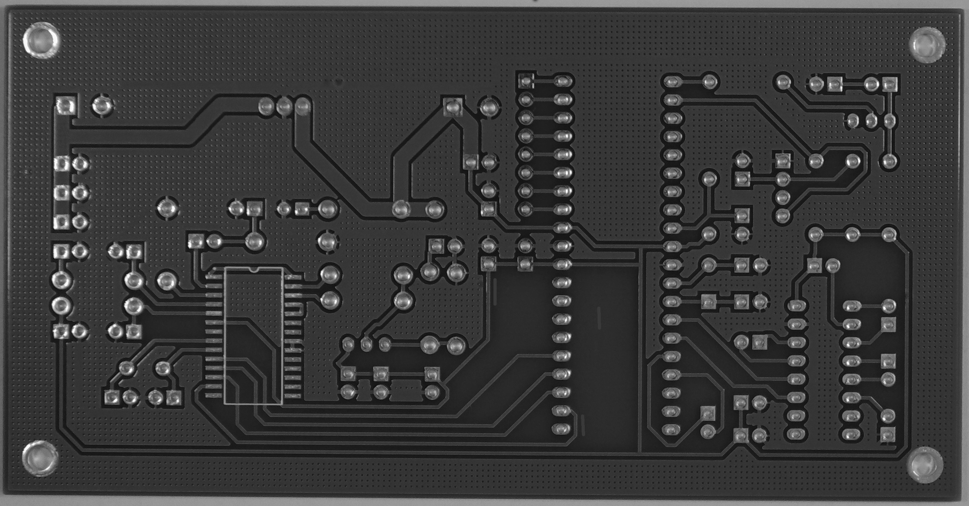




Flow Chart
normal image
anomaly image
gray scale
Label as .xml
Spurious_copper
1. normal – anomaly
2. ignore extreme
3. medium blur
-
Classify by image processing
Use cv2.findContour package
Get (x, y, w, h) and crop anomaly image
Notes:
01.JPG

Slide 3
Flow Chart
normal image
anomaly image
gray scale
2 for loop,
high complexity.
Label as .xml
Spurious_copper
1. normal – anomaly
2. ignore extreme
3. medium blur
-
Classify by image processing
Use cv2.findContour package
Get (x, y, w, h) and crop anomaly image
Notes:
01.JPG

Slide 4
Thanks for your attentions!

